Slide 1
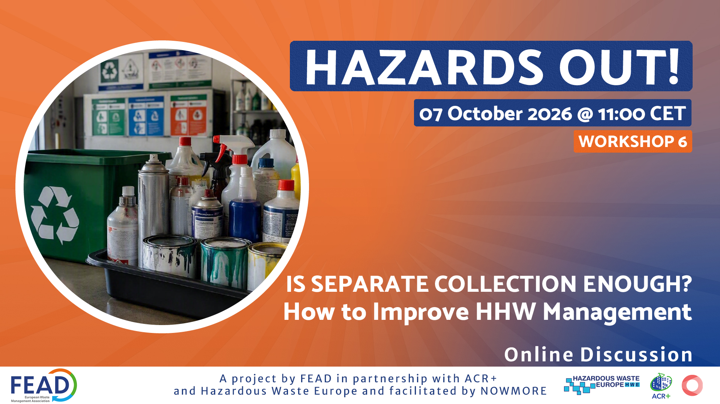

Slide 2
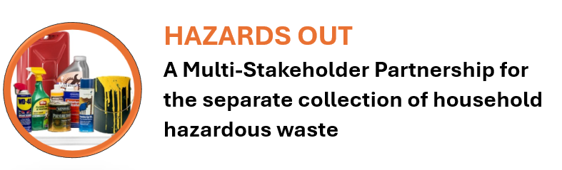
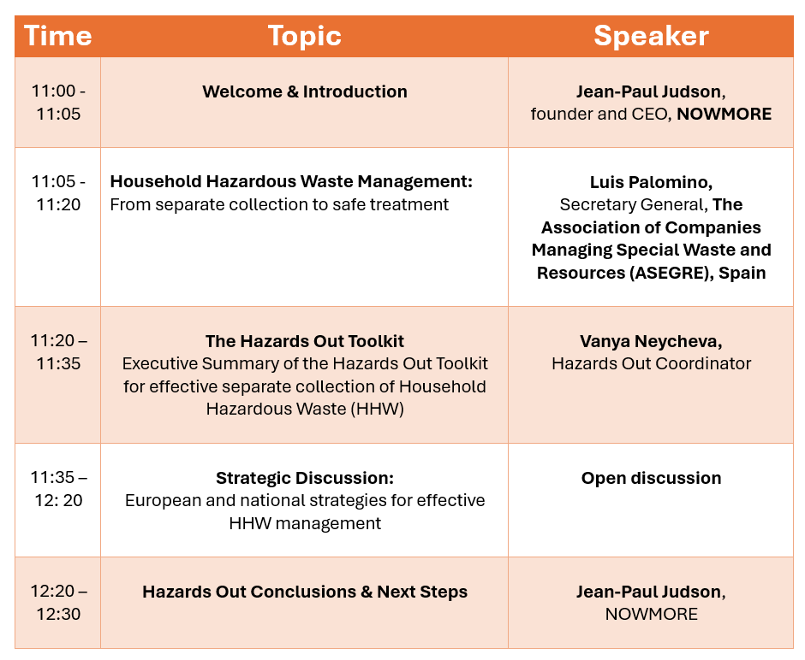
AGENDA

Slide 3

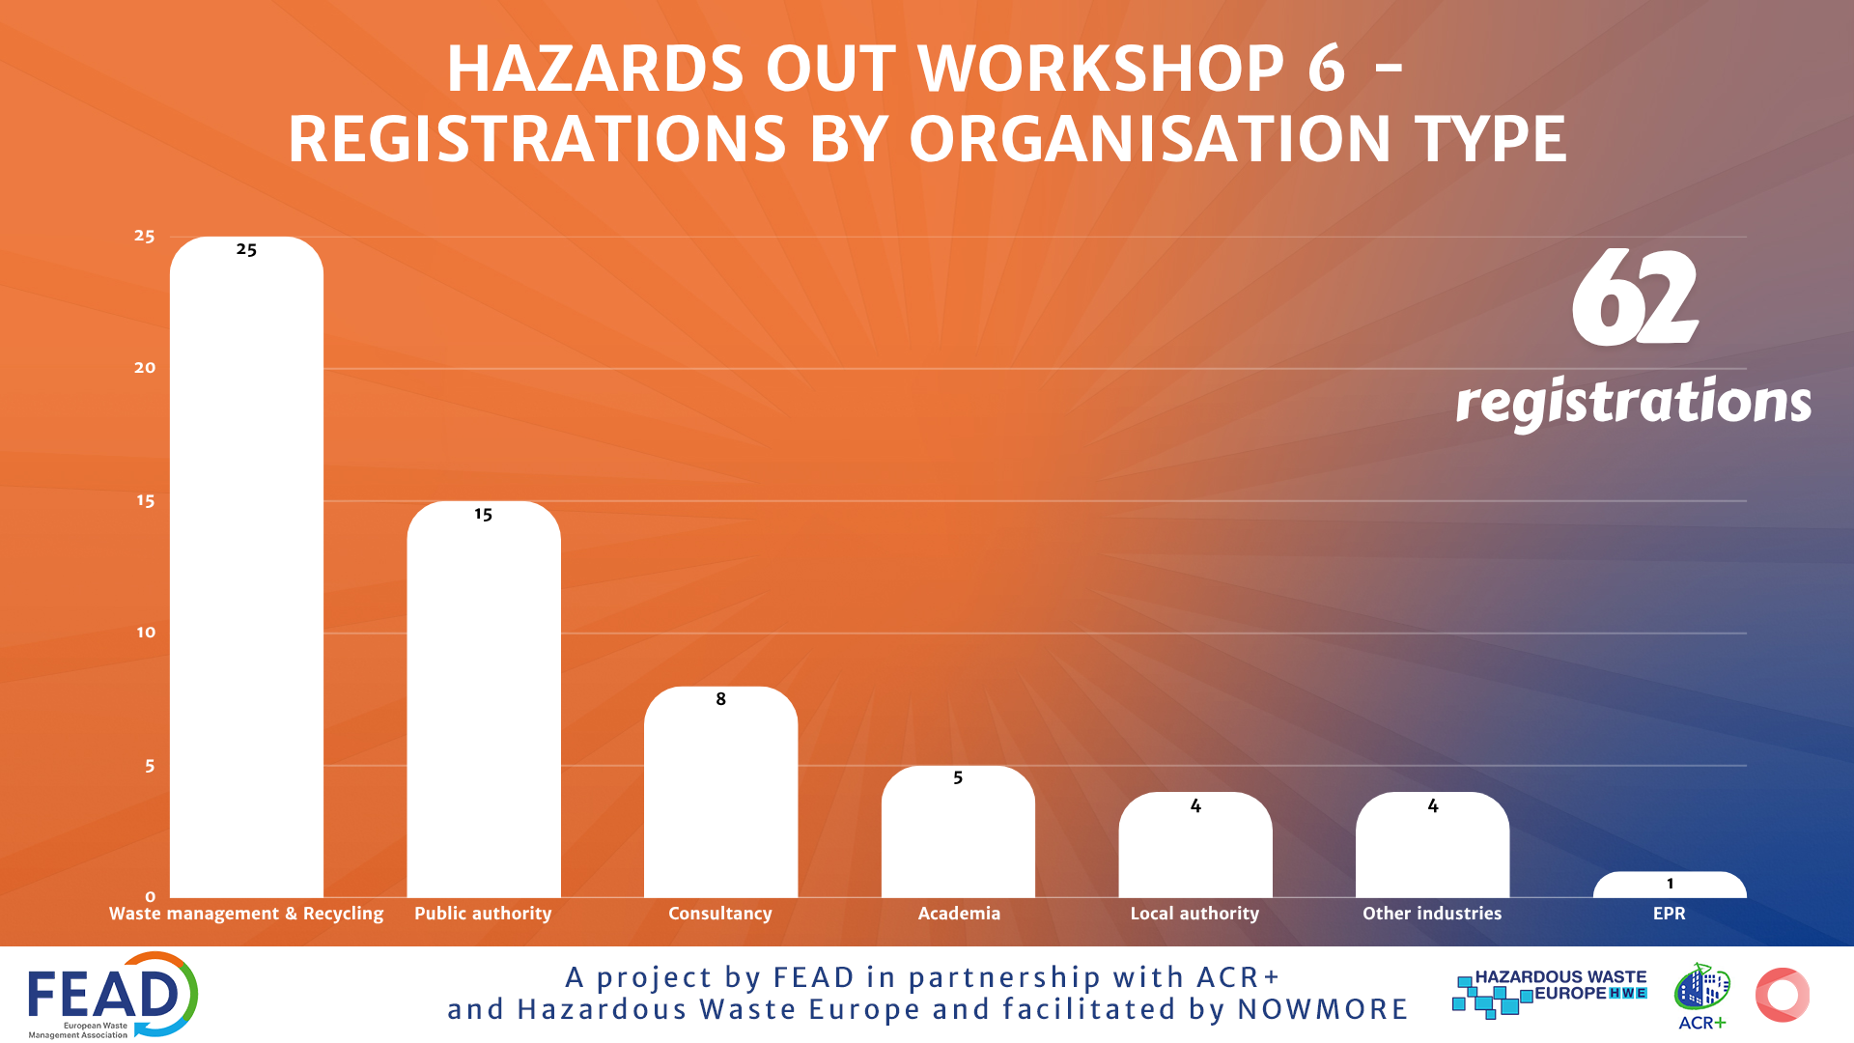




Hazards Out Workshop 6 -
Registrations by organisation type
A project by
in partnership with
and
facilitated by

Slide 4
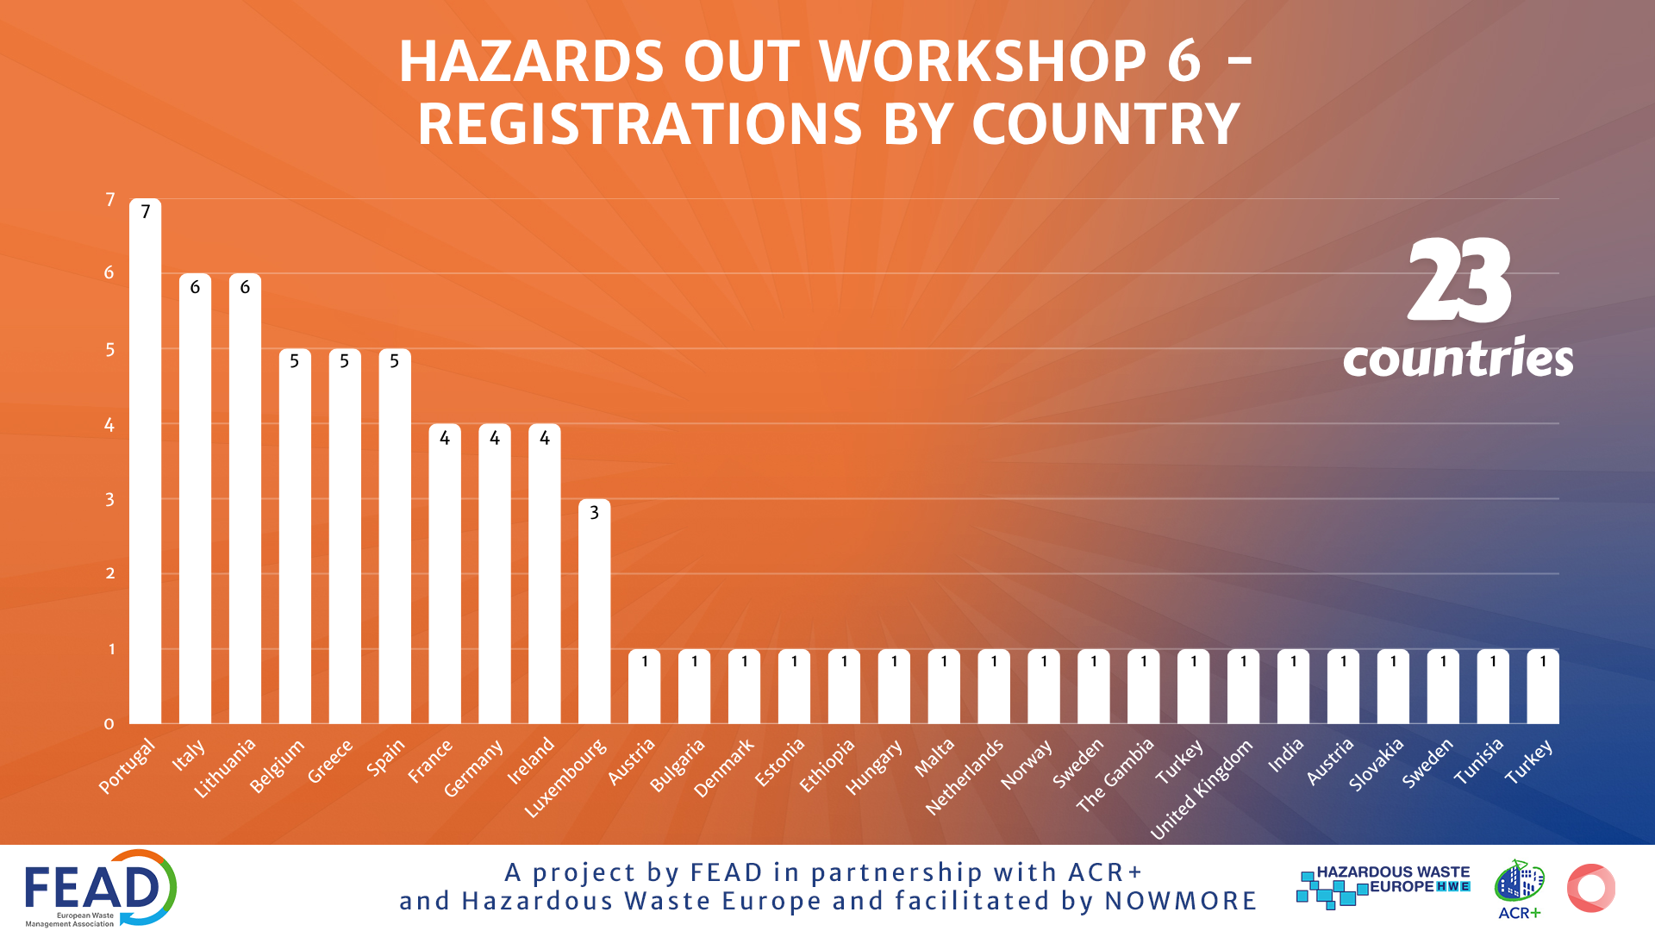

Slide 5
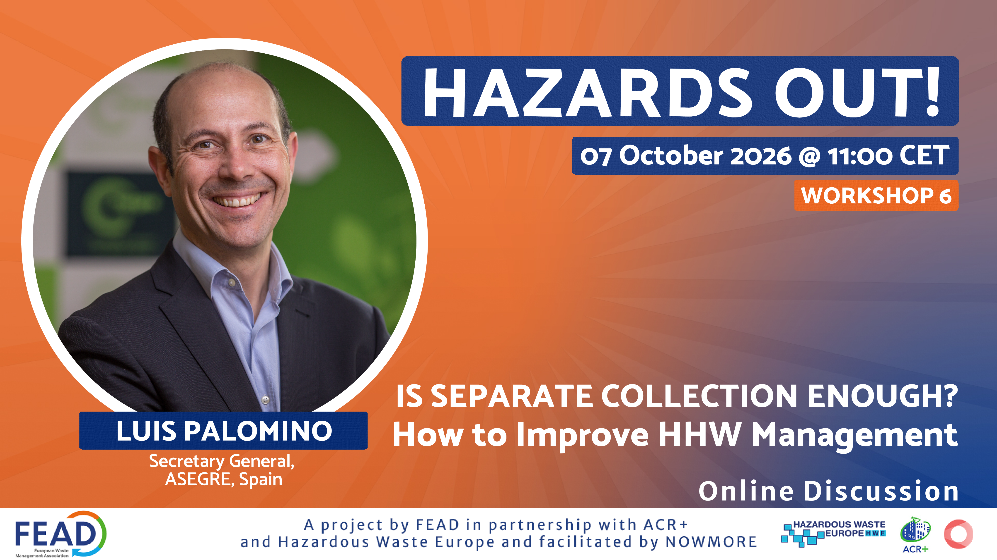

Slide 6

1%
HOUSEHOLD HAZARDOUS
WASTE MANAGEMENT
of municipal waste
excluding WEEE
Disproportionate risk
From separate collection to safe treatment
is separate collection enough?
Luis Palomino | Secretary General, ASEGRE
Hazards Out Workshop 6 | 7 October 2026

Slide 7
COMMISSION NOTICE 2020/C 375/01
The purpose of separate collection
01
Protect people
Reduce exposure for citizens and waste workers
02
Protect material streams
Keep hazardous substances out of mixed waste and facilitate treatment
03
Direct treatment
Send each fraction to suitable recovery or disposal
Prevention and reduction remain the first priority
HAZARDS OUT | ASEGRE
02

Slide 8
DIFFERENT FRACTIONS NEED DIFFERENT ROUTES
Household hazardous waste is a family of risks
FRACTION
MAIN CHALLENGE
COLLECTION ROUTE
Paints, solvents, adhesives
Open containers and unknown mixtures
Retailers, EPR channels, staffed collection or mobile services
Pesticides
Toxic, old or unlabelled products
Controlled delivery to trained staff
Medicines and sharps
Chemical, infection and injury risks
Dedicated pharmacy or health channels
Asbestos and treated wood
Unsafe handling by householders. Prevent illegal deposits
Specialist collection services
Automotive products
Oils, filters and antifreeze
Retailers, EPR channels or civic sites
WEEE and batteries
Fire risk, hazardous components and embedded batteries
Retail take-back, EPR channels and civic sites
Mercury waste
Breakage and toxic emissions
Protected separate containers
A single collection target cannot describe performance across these fractions
HAZARDS OUT | ASEGRE
03

Slide 9
LOCAL DESIGN WITHIN COMMON SAFEGUARDS
A combined collection network
01
02
03
04
05
Permanent centres
Mobile services
Collection on request
Retail take back
Dedicated schemes
Staffed facilities with safe storage
Periodic access in dispersed areas
Support for difficult or high risk items
Convenient channels linked to products
Specific routes under producer responsibility
Common EU and national safeguards
Accepted fractions
Safety requirements
Consistent information
Comparable indicators
Traceability to treatment
Convenience increases capture; trained control preserves safety
HAZARDS OUT | ASEGRE
04

Slide 10
FOUR SUCCESS FACTORS
The Commission’s implementation test
01
Economic incentives
02
Customised facilities
Who finances the full cost from collection to treatment?
Are sites accessible, staffed and equipped for each fraction?
03
Communication
04
Enforcement
Do citizens know what is hazardous and where it belongs?
Do authorities control collection, storage and treatment duties?
HAZARDS OUT | ASEGRE
05

Slide 11
ASEGRE PERSPECTIVE
The operator’s reality after collection
1
Small and irregular quantities
OPERATOR TASKS
2
Damaged or unlabelled packaging
01 Inspect and classify
02 Separate incompatible substances
3
Unknown and incompatible mixtures
03 Repack damaged containers
04 Analyse unknown products
4
Seasonal peaks and dispersed logistics
05 Select authorised treatment
5
Fractions without a viable recycling outlet
06 Manage rejects and contaminated packaging
A separately collected container may still hold an unsafe or untreatable mixture
HAZARDS OUT | ASEGRE
06

Slide 12
USEFUL EVIDENCE — BUT NOT YET COMPARABLE PERFORMANCE
What the cases tell us
≈1%
Low tonnage
HHW is a small share of municipal waste but creates disproportionate risk
5–7 kg
Irish households
Annual generation; small, inconsistent quantities and export dependence
66–75%
Paint in Odense
A heavy fraction can dominate the total and distort aggregate indicators
425+
Large batteries
Returned in the Feldbach incentive pilot through retailers and a resource park
35%
Recycled paint
Professional product demonstrated by AkzoNobel and Inter-CheM
HAZARDS OUT | ASEGRE
07

Slide 13
FROM FORMAL COMPLIANCE TO DEMONSTRATED RESULTS
Implementation gaps to examine in 2026
01
Territorial access
Distance, opening hours and frequency still determine participation
02
Accepted fractions
Different local rules can confuse citizens and fragment volumes
03
Comparable data
Total kilograms can hide weak capture of high risk fractions
04
Full cost financing
Collection is only one part of the management cost
05
Final treatment
Systems need evidence of the destination of each fraction
HAZARDS OUT | ASEGRE
07

Slide 14
COMPARABLE EVIDENCE ALONGSIDE LOCAL SOLUTIONS
A common performance framework
PREVENTION
Use and disposal of hazardous products
ACCESS
Coverage, distance, hours and frequency
CAPTURE
Quantity collected by fraction
QUALITY
Unknown waste, damage and incorrect deposits
SAFETY
Fires, spills, exposure and rejected deliveries
TREATMENT
Destination and treatment completed
COST
Full cost from collection to final treatment
Success means fewer hazardous substances in the wrong streams and safe treatment
for every collected fraction
HAZARDS OUT | ASEGRE
08

Slide 15
is separate collection enough?

Slide 16
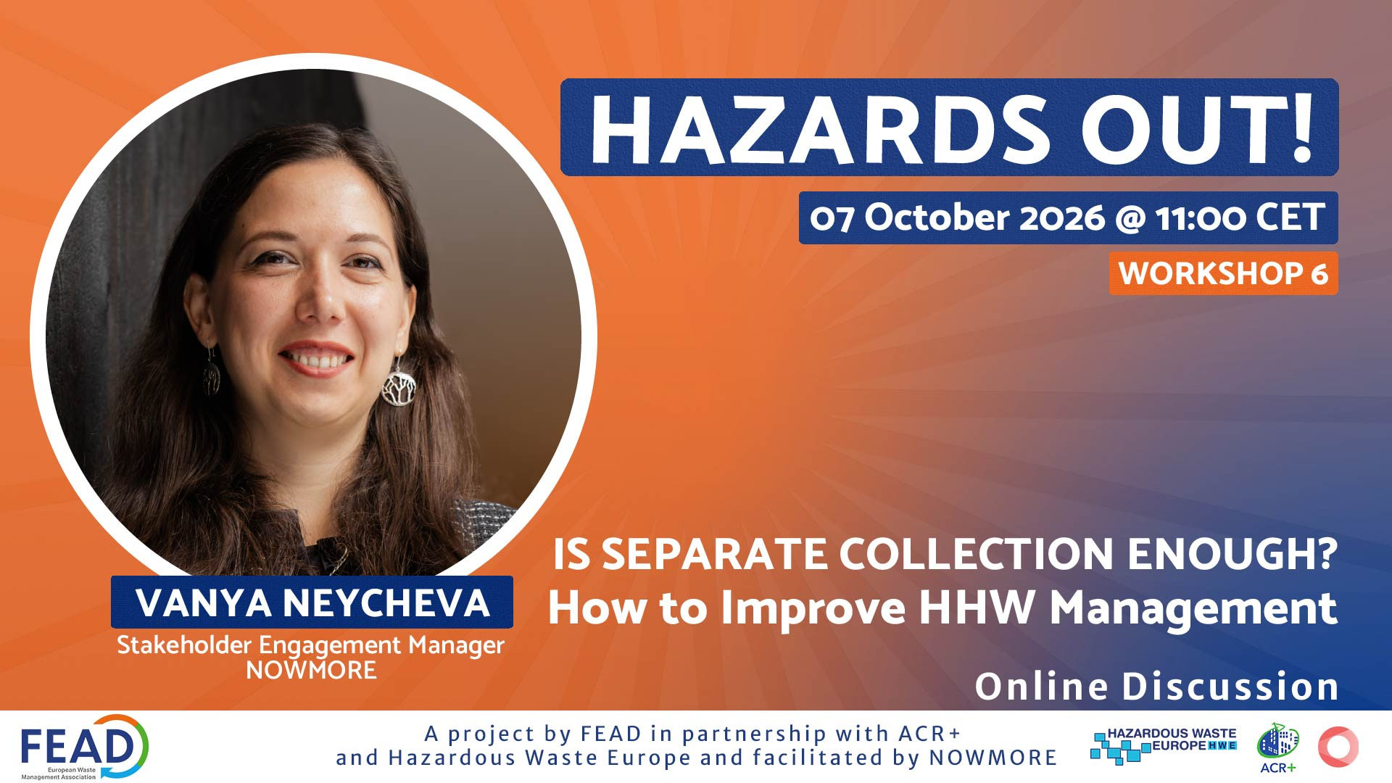

Slide 17

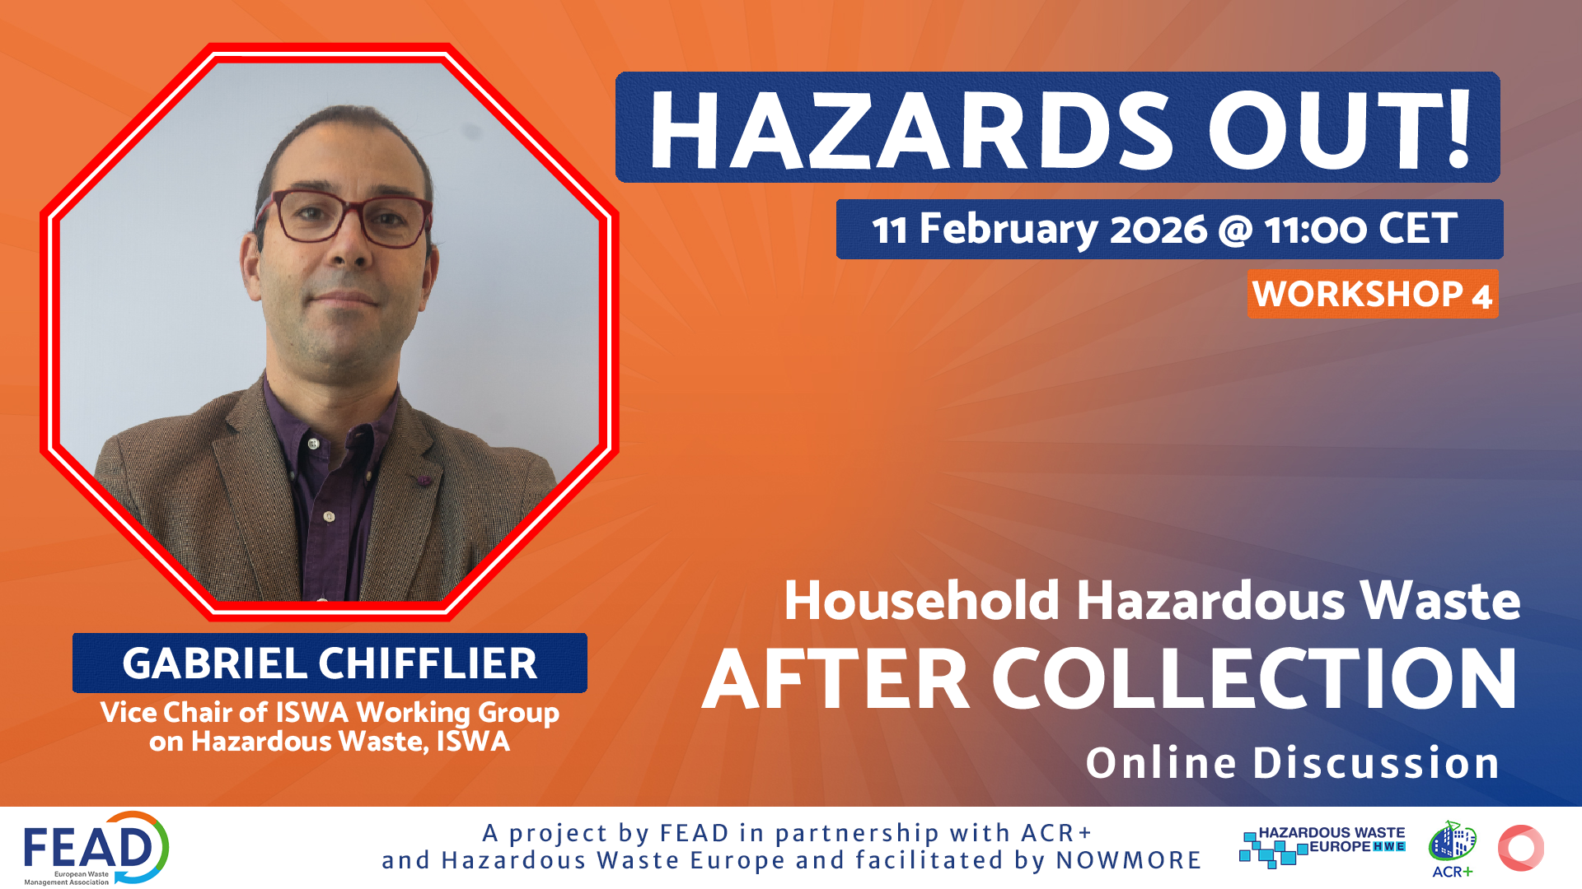
TOOLKIT
For the Effective Separate Collection of Household Hazardous Waste
EXECUTIVE SUMMARY

Slide 18
INTRODUCTION
Household hazardous waste (HHW) is a small fraction of municipal waste, but its characteristics and potential risks require dedicated attention. Generated from everyday household products and activities, HHW can include paints, solvents, adhesives, cleaning and garden chemicals, oils and automotive products, aerosols, pressure containers and other products containing substances or components with hazardous properties. If incorrectly handled or mixed with other waste streams, HHW can pose risks to citizens and waste workers, contaminate recyclable materials and create environmental and operational risks.
The separate collection of HHW is mandatory in the European Union since January 2025, as specified in Article 20 of the Waste Framework Directive. However, many European municipalities, waste management operators, and other professionals are still facing operational or financial challenges in the implementation of these separate collection obligations.
The introduction of this requirement represents an important step for the effective and sustainable HHW management, but establishing a legal obligation is only the starting point. Effective implementation requires appropriate collection systems, infrastructure, trained personnel, safe logistics, suitable treatment capacity, adequate financing, collaboration across the value chain with clear responsibilities, reliable information and active citizen participation.

Slide 19
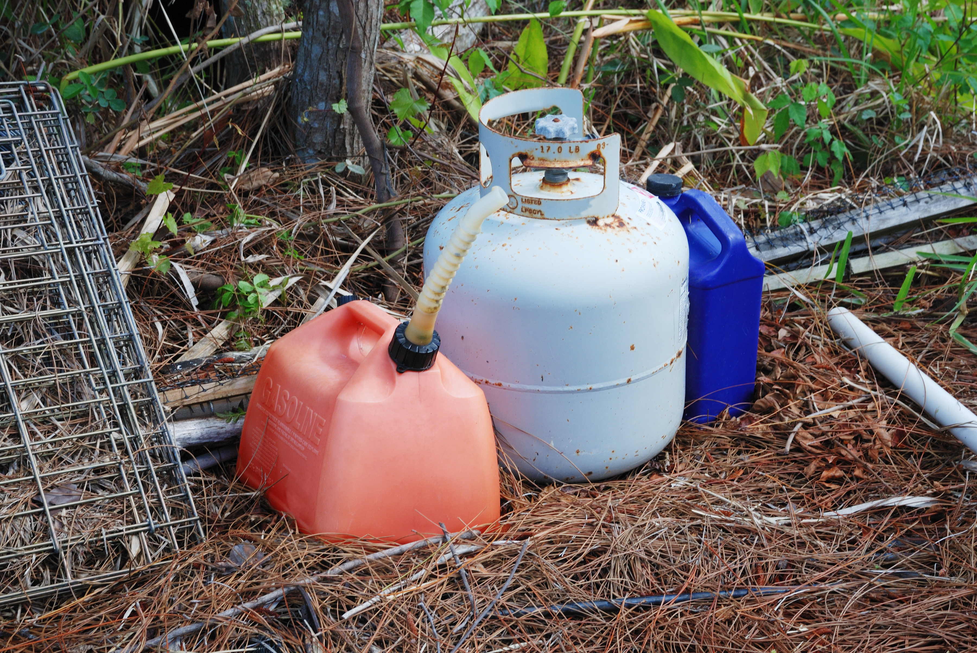



About HAZARDS OUT!
To address the specific and often overlooked waste fraction of household hazardous waste, the Hazards Out! initiative was established in October 2024 by FEAD, the European Waste Management Association, supported by HWE, Hazardous Waste Europe and ACR+, the Association of Cities and Regions for Sustainable Resource Management and facilitated by NOWMORE.
The partnership acknowledged the need to support the implementation of the EU requirements on the separate collection of HHW and to provide a platform for the exchange of knowledge and practical expertise for all stakeholders working with HHW across Europe.
The main objective of the project is to promote the effective implementation of the separate collection of HHW through exchange of best practices and collaboration within a European professional community of local authorities, waste management operators, industry, and other stakeholders.

Slide 20
Hazards Out Series of Workshops
The main activity of the Hazards Out initiative is the series of online workshops, bringing together an expert network to explore and define the different aspects of effective HHW management. The Hazards Out! project has engaged with municipalities, waste management operators, producer responsibility organisations (PROs), industry, European institutions, national environmental authorities, academia and other relevant stakeholders, to identify barriers, solutions, and opportunities for better HHW management across Europe.
12/02/2025
15/05/2025
24/09/2025
11/02/2026
03/06/2026
07/10/2026
Workshop 1
Workshop 2
Workshop 3
Workshop 4
Workshop 5
Workshop 6
Household Hazardous Waste | What is going to change?
HHW Collection methods
Household Hazardous Waste After Collection
Citizen Communication
on Household Hazardous Waste
Is separate collection enough? How to improve HHW management
Does EPR have a role to play?

Slide 21
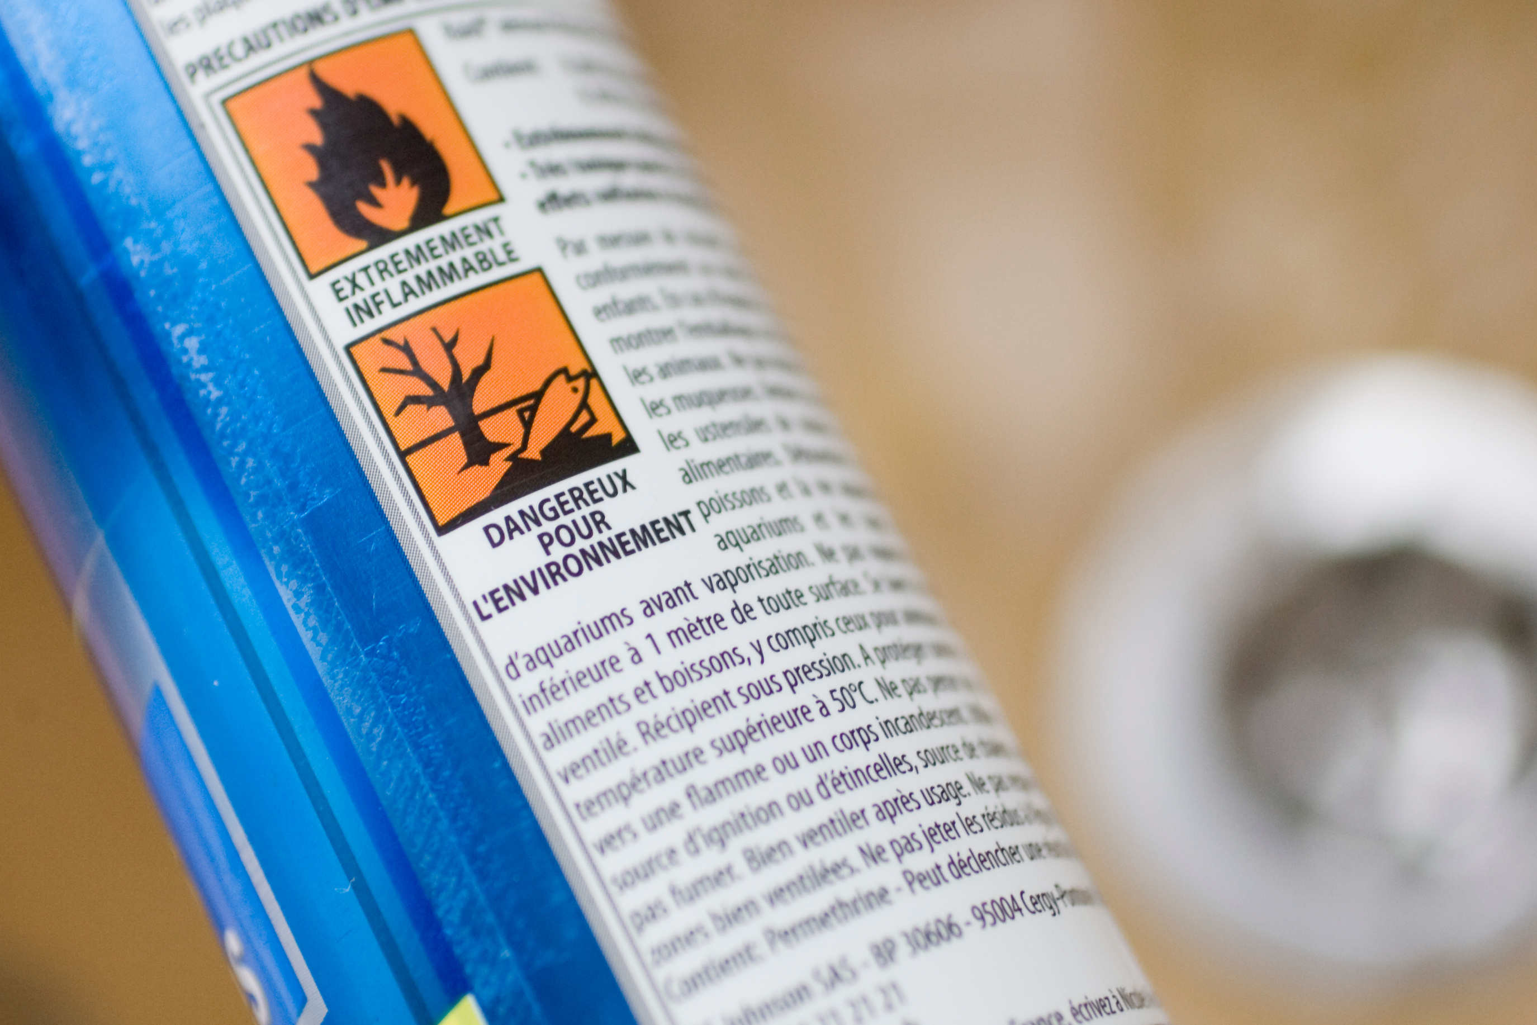
About the Toolkit
The Hazards Out Toolkit for the Effective Separate Collection of Household Hazardous Waste is intended as a practical and knowledge-based resource for stakeholders involved in designing, implementing and improving the HHW management across Europe.
The Toolkit has two main purposes:
To serve as a practical tool and guidance for professionals
To provide additional resources for policymakers involved in developing governance frameworks, strategies and support measures for effective HHW management.
The main objective of the document is to support the relevant stakeholders to manage HHW in a compliant, effective, and sustainable way adapted to their specific national, regional or local circumstances and to provide good practice examples from across Europe.
The Toolkit does not replace legislation, national requirements or technical guidance, nor does it propose a step-by-step implementation manual that can be applied across Europe.

Slide 22
METHODOLOGY
The Toolkit builds primarily on the knowledge and experience generated through the Hazards Out series of thematic workshops, complemented by case studies, stakeholder contributions, existing guidance and expert resources.
Learning Objectives:
► Understand the characteristics and risks associated with HHW
► Recognise the European legal and policy context
► Gain an overview of different local and national approaches to HHW collection and management across Europe
► Identify key considerations when planning and implementing separate collection for effective and sustainable HHW management
► Learn from practical examples and case studies on collection methods
► Draw key considerations for safe collection, storage, transportation, treatment, and when possible, recovery of HHW
► Understand the potential role of Extended Producer Responsibility schemes in the effective HHW management
► Support effective communication and citizen engagement strategies for effective identification and sorting at source of HHW
► Place the separate collection of HHW into broader sustainable waste management strategies
► Support dialogue and cooperation between the different actors involved in HHW management

Slide 23
CONTENT OVERVIEW
CHAPTER 1
CHAPTER 2
CHAPTER 3
CHAPTER 4
What is HHW? Definitions and European legislative framework
  Household Hazardous Waste Definition
  The Circular Economy and HHW
  European Legislative Framework
Separate collection: From legal obligation to implementation
  Designing a HHW collection system
  Collection Methods Overview
  The role of Extended Producer Responsibility schemes
Effective HHW management: From collection to safe treatment and engagement
  Citizen communication and awareness
  The Collection Point
  Transportation
  Treatment
  Product focus: Paint reuse and recycling
Key factors for effective HHW management

Slide 24
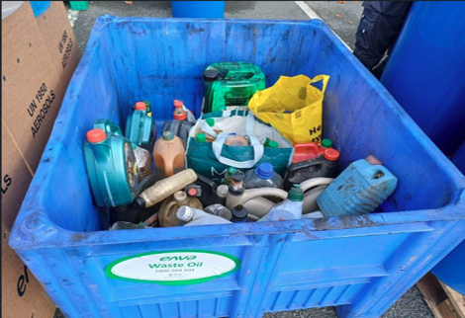
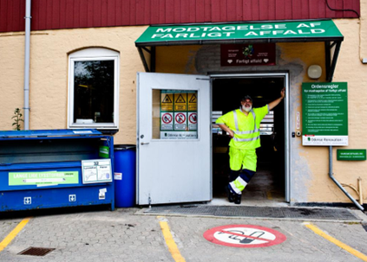
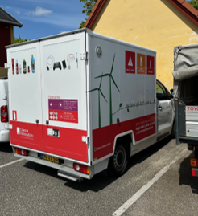

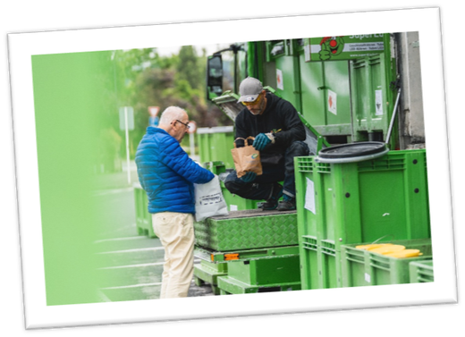
MAIN FINDINGS
Separate collection is the foundation of an effective HHW management but not the whole system.
There is no single governance model or collection method applicable across Europe
Logistics and treatment are important part of the effective HHW management system
Citizen communication is an integral part of the infrastructure
Effective HHW management requires value chain cooperation and clear responsibilities

Slide 25
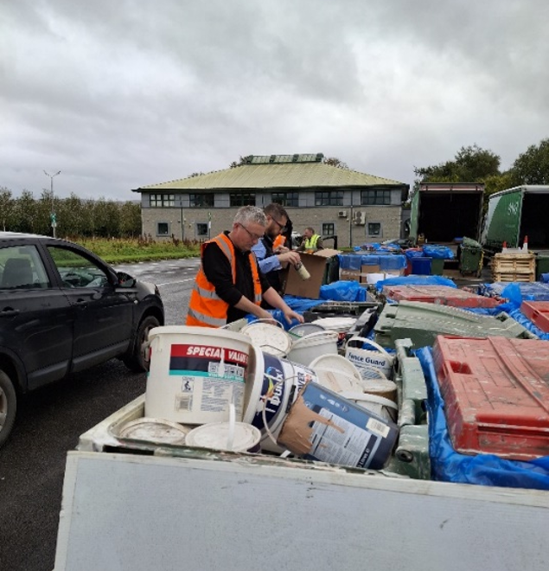
Key considerations for stakeholders
Clear responsibilities and coordination across the value chain
Define who is responsible for each stage of the HHW management chain including collection, transport, storage, treatment, communications, data collection and monitoring, while maintaining regular dialog and coordination.
Design the HHW collection system around what is generated
Design the collection system based on the local HHW characteristics in terms of types, quantities, geographical distribution and seasonality of HHW for flexible and efficient services instead of a one-size-fit-all model and review the collection periodically.

Slide 26
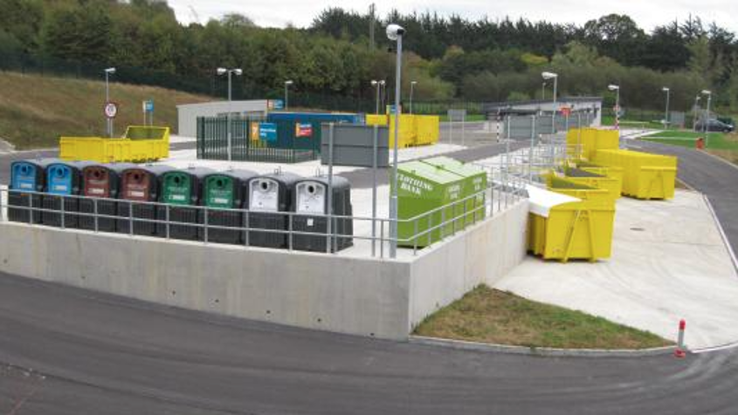
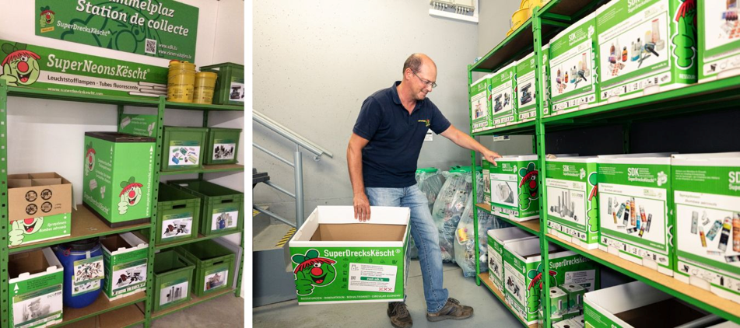
Key considerations for stakeholders
Ensure sustainable funding
Shared responsibility across the value chain is essential to contribute financial resources, technical expertise and long-term infrastructure investments to guarantee the effective separate collection and treatment of HHW.
If possible, combine collection methods to provide a comprehensive and accessible service
Use a combination of collection methods to provide sufficient geographic coverage with clear information which products or substances are accepted at each collection point and in what volumes. Ensure that collection sites and events have sufficient capacity and appropriately trained personnel. Where collection events are used, plan for expected peaks and traffic management.

Slide 27
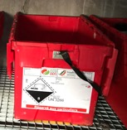
Key considerations for stakeholders
Make sorting at source a fundamental requirement with clear instructions
Keeping hazardous waste separate from non-hazardous waste is the fundamental principle for effective HHW management.
►Provide clear and practical sorting instructions to citizens.
►Use clearly identified and appropriate containers for different waste categories, when relevant.
►Ensure that collection staff can identify and manage substances that are unknown, incorrectly labeled, damaged or potentially unsafe.
►Provide specific arrangements for potentially dangerous waste such as gas cylinders, aerosols, etc.

Slide 28
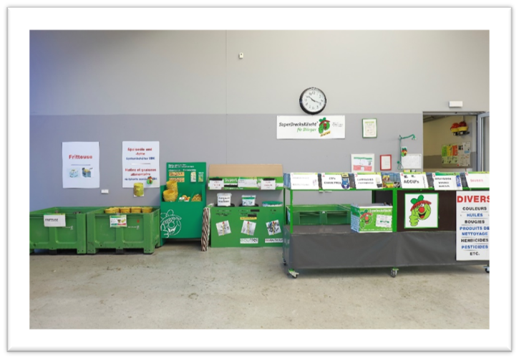
Key considerations for stakeholders
Well-equipped collection points
Ensure that waste management staff and other involved professionals in the HHW collection points are trained to recognise common HHW categories and associated hazards and the required safety protocols and equipment are in place.
►Provide appropriate safety and emergency procedures.
►Use appropriate containers and ensure they are available in sufficient quantities.
►Maintain clear separation between incompatible materials.
►Regularly review collection-point risks and operational performance.

Slide 29
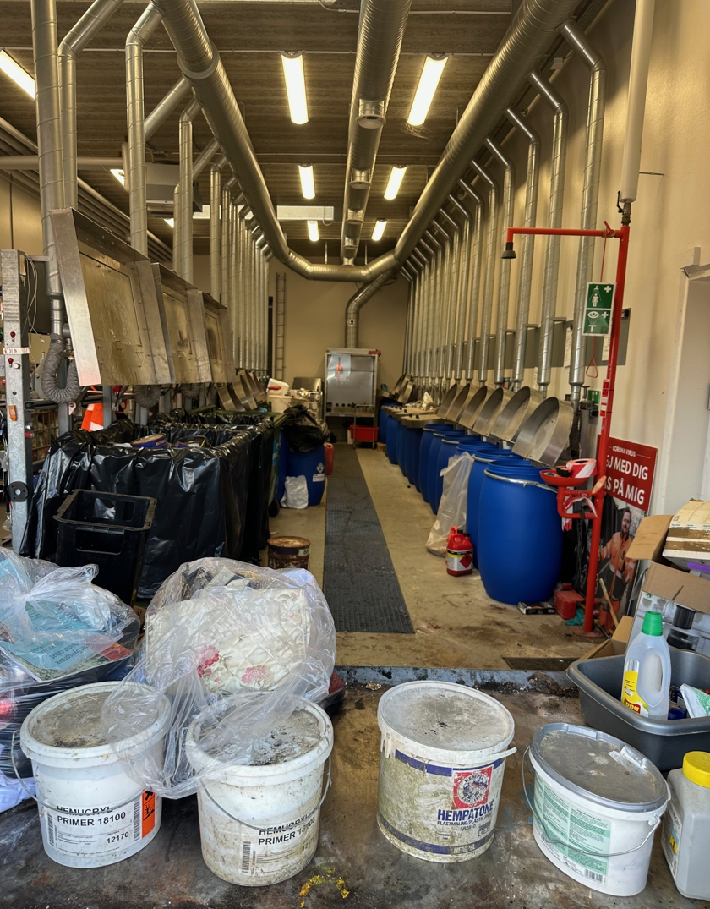
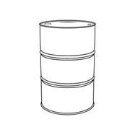
Key considerations for stakeholders
Manage storage as a controlled stage of the waste chain
Temporary storage should be planned as an integral part of the system using appropriate space and safety measures. Where quantities are small or collection is geographically dispersed, consolidation and intermediate storage may be necessary. However, these stages need to remain controlled and traceable.
►Provide protection against leakage, fire and other foreseeable risks and procedures for emergency situations.
►Control access to storage areas.
►Ensure that storage areas are suitable for the quantities and types of HHW generated.
►Monitor storage capacity and collection frequency to avoid unnecessary accumulation.

Slide 30
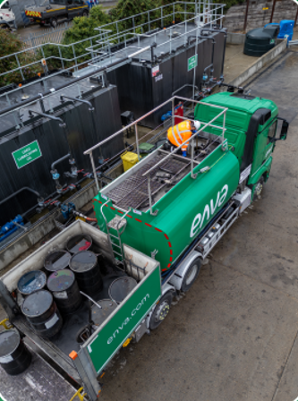

Key considerations for stakeholders
Plan safe and compliant transportation
Transport should be safe, compliant and designed in accordance with the risks presented by the waste.
►Classify, package, and label waste appropriately before transport.
►Apply applicable dangerous goods requirements, including ADR requirements where relevant.
►Ensure drivers and other personnel have the necessary training and competence.
►Maintain the required documentation and consignment records.
►Plan routes and collection frequencies to avoid unnecessary storage and transport.
►Consider consolidation where small quantities make direct transport inefficient.

Slide 31

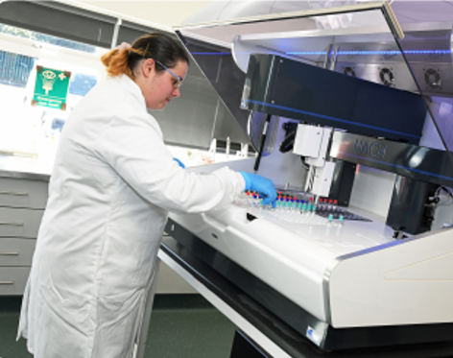
Key considerations for stakeholders
Characterise and sort HHW before pre-treatment and disposal
Characterisation and control are a basic part of HHW risk management, preventing risks to human health, industrial operations and the environment. It also facilitates the selection of the most appropriate treatment route.
►Do not treat unknown or mixed HHW as if its composition and risks were known.
►Inspect and classify waste before treatment.
►Use sampling and laboratory analysis where necessary.
►Use pre-treatment, depackaging or other preparation where necessary to make treatment safer and more effective.
►Keep track of the information on the composition and characteristics of incoming waste through the process.

Slide 32
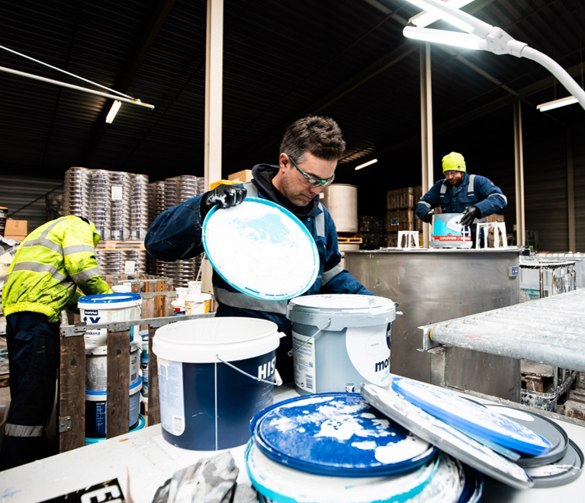
Key considerations for stakeholders
10
Treat HHW according to its characteristics and the waste management hierarchy
Use the appropriate treatment required for the specific waste and respect the waste management hierarchy, where technically feasible, safe and compliant with applicable legislation.
11
Invest in people, expertise and operational safety
Infrastructure alone does not deliver effective HHW management, which is why staff training is essential

Slide 33

Key considerations for stakeholders
12
Make citizen communication an integral part of the HHW management system
Limited awareness about HHW and lack of information about collection options can be barriers to participation and lead to insufficient performance.
►Explain clearly what HHW is and why it must be collected separately.
►Tell citizens exactly what is accepted and what is not.
►Provide clear information on where, when and how HHW can be disposed of.
►Explain how materials should be prepared, packaged and transported.
►Use simple sorting instructions and consistent messages across collection points and communication channels.
►Repeat information through different channels and at relevant moments.
►Consider collecting feedback, surveys and participation data to improve future campaigns.

Slide 34

Key considerations for stakeholders
13
Establish data, traceability and performance monitoring
Data, material characterisation, KPI monitoring and reporting should be part of the operational excellence of HHW management.
►Record quantities and categories of HHW collected.
►Record recovery and disposal outcomes.
►Monitor participation and communication performance where possible.
►Use digital tools and data to identify bottlenecks and improve the collection system.
►Establish common reporting approaches across different operators and collection channels where feasible.
14
Apply a value chain approach

Slide 35

CONCLUSION
HHW should be approached as a specific waste stream that requires professional management from generation to final treatment. Even if small in volume, HHW should not lead to risks, unnecessary costs or harm. Effective systems combine prevention, clear citizen instructions, proper segregation, accessible collection, safe logistics and storage, competent personnel, appropriate treatment and recovery, reliable data and sustainable financing. The strongest systems are those in which these elements are planned together and continuously improved through cooperation across the value chain.
Learn more on the Hazards Out Website.
Presented by:
Vanya Neycheva, Hazards Out Coordinator, Vanya@nowmore.eu

Slide 36


Effective Household Hazardous Waste Management
DISCUSSION

Slide 37
THANK YOU FOR JOINING US!
LET’S STAY CONNECTED!
www.hazardsout.eu
Vanya Neycheva
Hazards Out Coordinator,
vanya@nowmore.eu

